Slide 1
Greater Intensity = Faster Cortical Response
These “data” are for
illustration only.

Slide 2
Greater Intensity = Faster Cortical Response

Slide 3
Greater Intensity = Faster Cortical Response
Sensory Neurons Differ In Firing Threshold

Slide 4
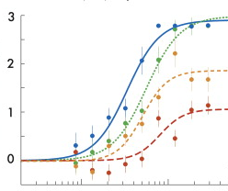
Greater Intensity = Faster Cortical Response
Sensory Neurons Differ In Firing Threshold
Firing Rate *100 per second
Low
High
Stimulus Intensity

Slide 5
Greater Intensity = Faster Cortical Response
Sensory Neurons Differ In Firing Threshold
Low
Threshold
Neuron
High Sensitivity
Firing Rate *100 per second
High
Threshold
Neuron
Low Sensitivity
Low
High
Stimulus Intensity

Slide 6
Greater Intensity = Faster Cortical Response
Only Sensitive Neurons Fire at Low Stimulus Intensity
Low
Threshold
Neuron
High Sensitivity
Firing Rate *100 per second
High
Threshold
Neuron
Low Sensitivity
Low
High
Stimulus Intensity

Slide 7
Greater Intensity = Faster Cortical Response
Less Sensitive Neurons Fire at High Stimulus Intensity
Low
Threshold
Neuron
High Sensitivity
Firing Rate *100 per second
High
Threshold
Neuron
Low Sensitivity
Low
High
Stimulus Intensity

Slide 8
Greater Intensity = Faster Cortical Response
At the highest intensities “all” neurons fire maximally
Low
Threshold
Neuron
High Sensitivity
Firing Rate *100 per second
High
Threshold
Neuron
Low Sensitivity
Low
High
Stimulus Intensity

Slide 9
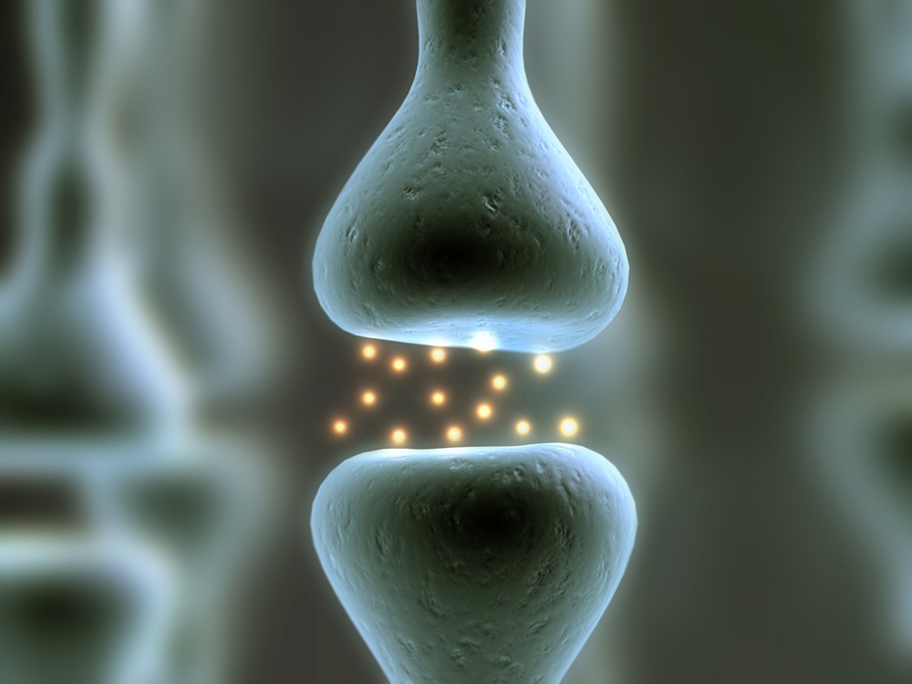
Pre-Synaptic
Neuron
Synapse
Post-Synaptic
Neuron

Slide 10
Pre-Synaptic
Neuron
Releases
Neurotransmitter
Into the Synapse
Synapse
Post-Synaptic
Neuron
Integrates
&
Fires

Slide 11
Pre-Synaptic
Neuron
Releases
Neurotransmitter
Into the Synapse
Higher Stimulus
Intensities
Generate More
Pre-synaptic
Neurotransmitter
Release.
Synapse
Increases in
Neurotransmitter
Drive
Post-Synaptic
Neurons More
Quickly To Their
Spiking Threshold.
Post-Synaptic
Neuron
Integrates
&
Fires

Slide 12
Integrate & Fire Neurons

Slide 13
Integrate & Fire Neurons
When More Faucets Release More Water,
The Bath Tub Spills Over Faster.

Slide 14
Integrate & Fire Neurons
When More Faucets Release More Water,
The Bath Tub Spills Over Faster.
When more pre-synaptic neurons release more neurotransmitter,
Post-synaptic Neurons Reach Their Spiking Thresholds (“spill over”) Faster.

Slide 15
Integrate & Fire Neurons
When More Faucets Release More Water,
The Bath Tub Spills Over Faster.
When more pre-synaptic neurons release more neurotransmitter,
Post-synaptic Neurons Reach Their Spiking Thresholds (“spill over”) Faster.

Slide 16
Greater Intensity = Faster Cortical Response
These “data” are for
illustration only.

